Slide 1
It Takes a Village
School Involvement
& Communication
7.20.18
Notes:
TELL: Place Holder

Slide 2
It Takes a Village
School Involvement
& Communication
7.20.18
Notes:
TELL: Place Holder

Slide 3
It takes a village to raise a child.
- African Proverb
Notes:
TELL: How many of you have heard of the African proverb, “It takes a village to raise a child” has been widely quoted to refer to entire communities of different people working together to promote the safekeeping and growth of the children.

Slide 4
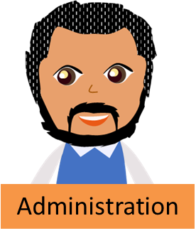
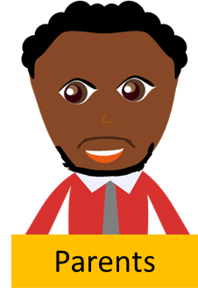
The Village
Child
Notes:
TELL: So how does this apply to our schools. Our schools are mini examples of villages consisting of people in different roles that work together for the sole purpose to support the children in multiple perspectives.

Slide 5
The Village
The Village is an interconnected network of individuals that come together to support the child as a whole.
Notes:
TELL: Our schools are mini examples of villages consisting of people in different roles that work together for the sole purpose to support the children in multiple perspectives.

Slide 6
You are a part of that Village!
Notes:
TELL: You are a part of that village! In fact, we play a very important role throughout the career of the students.

Slide 7
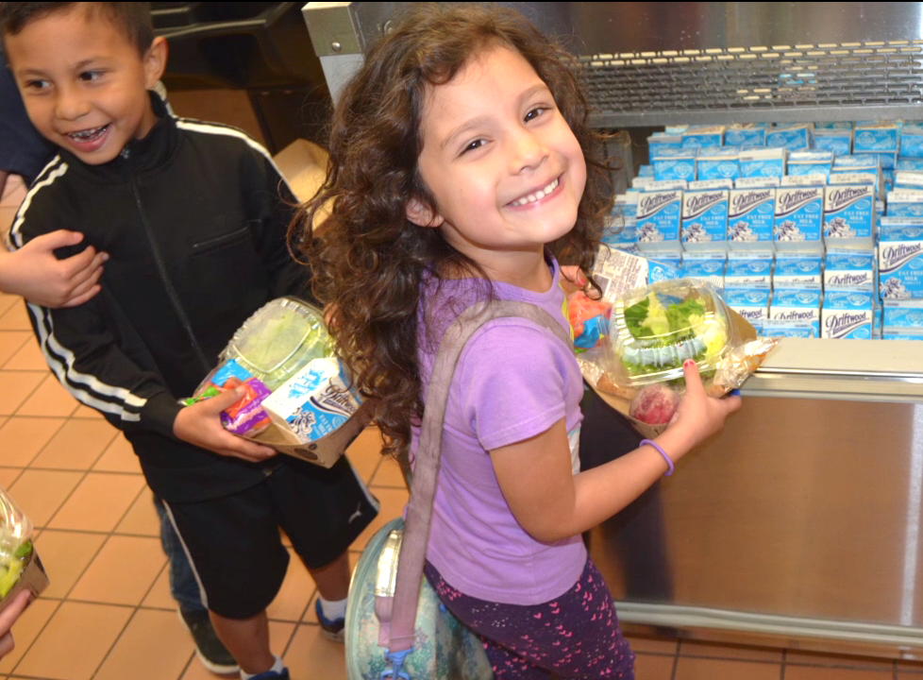
More Than Just Meal Time
Before children can learn,
their tummies need to be filled.
We have the opportunity to interact with children at their favorite parts of the school day. Each day we support the students, we build trust, and help create a village that fosters learning and growth.
Notes:
TELL: As a part of Food Services, we are fortunate to have the opportunity to interact with children at their favorite parts of the school day Each day we support the students, we build trust and help create a village that fosters learning and growth.

Slide 8
Be Seen
& Heard
Regularly
Participate in School Events
Integrate Yourself in Your School Community
Build Relationships with Students, Parents & Faculty
Be of Service
Notes:
TELL: Be an active member of the village and integrate yourself in your school community. First and foremost, it is important that you are seen and heard regularly. Show your support and participate in school events. Build long-lasting, engaging relationships with students, parents, and faculty. Lastly, radiate a ready-to-serve persona. Always be on your toes ready to answer questions or help.

Slide 9
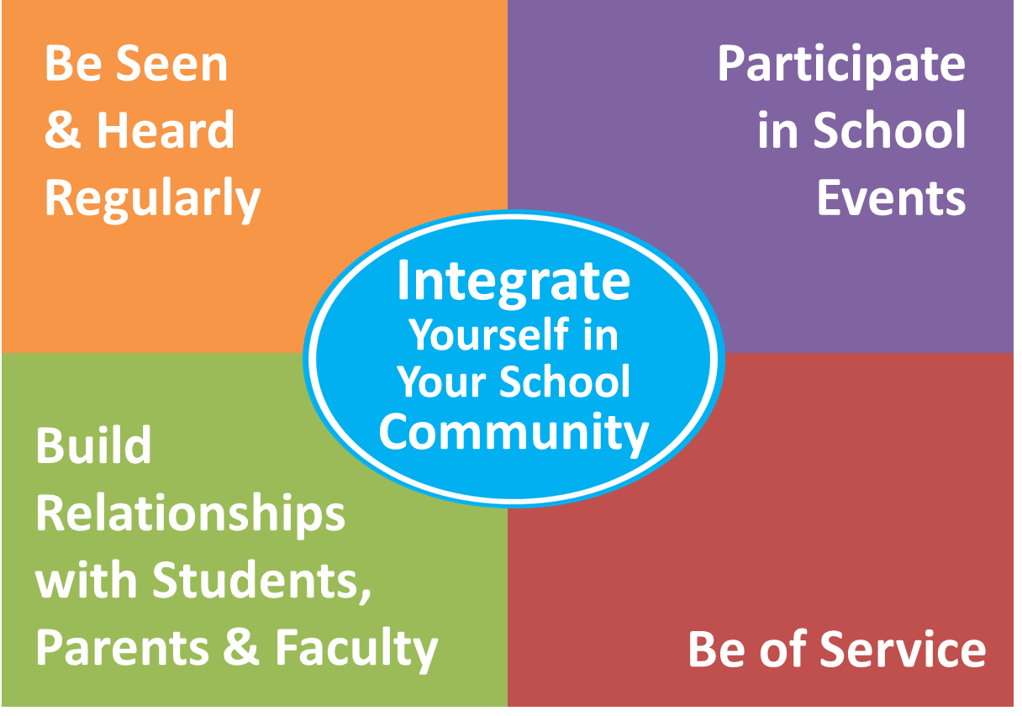
Brainstorm Activity
In groups of 3-5, discuss and brainstorm ideas on how you can integrate yourself in your school village.
Be ready to share your ideas with the class!
Notes:
ACTIVITY
TELL: Keeping the following categories in mind, discuss and brainstorm ideas on how you can integrate yourself in your school village. Write your answers and be ready to share your ideas with the class!
CALL ON VOLUNTEERS TO SHARE THEIR IDEAS.

Slide 10
What can you do to be seen and heard on your school campus?
Have Regular Meetings with Principal
/Admin.
Have Regular Meetings with Principal
/Admin.
Speak at Parent Meetings
Speak at Parent Meetings
Speak at Parent Meetings
Speak at Teacher Meetings (PD)
Fun Food Fact on the School Newsletter
Food Sampling
Air Time on the PA
Be Seen
& Heard
Regularly
Notes:
ASK: Is everyone ready to share their examples? What can you do to be seen and heard on your school campus?
SOLICIT AUDIENCE RESPONSE
TELL: Have regular meetings with principal and administration. This will keep you up to date with all school happenings. Speak at parent meetings. Often times principals will host monthly meetings such as coffee with the principal to share vital information and to keep parents involved. The parents that attend these meetings are typically the most involved at the school, and are a voice for other parents. Speak at teacher meetings. Request 2 to 3 minutes in the beginning of the meeting to share any updates, comments and concerns during the meeting. By doing this you promote open communication between all school partners. Air time on the P.A. This is a free resource that we often do not utilize. A short but informative message regularly can improve student participation. Fun food fact on the school Newsletter. Adding a fun food fact on the newsletter is a great way to encourage students to make healthier food choices. Food Sampling. Food sampling is an effective marketing practice that large warehouse companies use to promote new food items to their customers. Its one things to tell students that the food is good and another for the students to experience it themselves.

Slide 11
How do you show your participation and involvement?
Participate in School Assemblies and Rallies
Participate in School Assemblies and Rallies
Attend Spring Carnivals, Multicultural Festivals, etc…
Attend Spring Carnivals, Multicultural Festivals, etc…
Show Support by Attending Awards Ceremonies
Show Support by Attending Awards Ceremonies
Speak at Parent Meetings
Speak at Parent Meetings
Speak at Parent Meetings
Speak at Parent Meetings
Show Your School Spirit on Spirit Day
Show Your School Spirit on Spirit Day
Participate in Faculty Events
Participate in Faculty Events
Participate in School Events
Notes:
ASK: How do you show your participation and involvement?
SOLICIT AUDIENCE RESPONSE
TELL: Show your school spirit by participating on Spirit Day! This shows the students and teachers your school pride and emphasizes unity and cohesiveness amongst your staff. Participate in school assemblies and pep rallies. What I mean by participating is simply showing up to share in the same fun and excitement that the students are experiencing. It will keep you current on all school happenings and give you something to talk about with the students. Be supportive and cheer on students at awards ceremonies for student of the month and perfect attendance. This is an achievement that the students are proud of, seeing you support them will just make it even sweeter! Attend Spring Carnivals, multicultural events etc. Participate in faculty events like potluck, staff appreciate, birthdays. Celebrations like these are often held in the faculty lounge, offer to take their photo and make sure you greet the celebrant!

Slide 12
How can you build positive relationships with students, parents, and faculty?
Smile and Spread Positivity
Speak at Parent Meetings
Speak at Parent Meetings
Rewards Program for Students
Learn Names
Initiate Conversation
Express Your Appreciation
Build Relationships
Notes:
ASK: How can you build positive relationships with students, parents, and faculty?
SOLICIT AUDIENCE RESPONSE
TELL: First and foremost, we must ensure that we spread a positive persona by making the conscious effort to smile. They say smiling is contagious. How can you keep up a frown if the people around you are constantly smiling. Be proactive and initiate conversations with people you interact with. Simple greetings can lead to conversations that help deepen connections with students, faculty and parents. Don’t forget to express your appreciation. It is a basic human need to feel appreciated, express appreciation to the faculty for all they do, parents for raising outstanding citizens, and the students for coming in to your cafeteria everyday. Learn people’s names. There is a psychological reason why Starbucks uses your name to call out your drink, and not a number or the drink itself. Addressing the faculty, parents, and students by their names is a sign of courtesy and makes them feel important. Partake in a rewards program to recognize children with good behavior by giving them front of the line passes, “tickets” and stickers. Not only will this practice encourage good behavior, but also promote excitement and possibly increase participation.

Slide 13
How can you show that you are ready to serve?
Visit BIC Classes to Educate & Assist
Ask Administration if They Need Anything
Speak at Parent Meetings
Be Available & Approachable
Offer Catering Services to Faculty
Be of
Service
Notes:
ASK: How can you show that you are ready to serve?
SOLICIT AUDIENCE RESPONSE
TELL: Always be available and approachable, be ready to help or answer any questions. Often times, the faculty is not aware of our catering services. Be sure to offer catering for their meeting and trainings. Visit BIC classes regularly to educate, assist and encourage students to eat their breakfast.. Lastly, do not hesitate to ask administration if they need anything.

Slide 14
Importance of Communication
Communication is paramount in the success of your Café LA operation. As the Food Services Manager, you must be able to communicate effectively with the school “Village”.
Notes:
TELL: Communication is a vital part of your Café LA operation. As a manager you must be able to communicate effectively with the school "Village".

Slide 15
MYTH
REALITY
OR
We communicate primarily through words only.
M
R
Notes:
ACTIVITY
TELL: Lets play a game. I am going to read you a statement about communication, you tell me if you think it’s a Myth or Reality?
We communicate primarily through words only.
SOLICIT AUDUIENCE RESPONSE
TELL: This is a myth, there are many different ways to communicate other then using words.

Slide 16
MYTH
REALITY
OR
Communication is one-sided and controlled by the speaker.
M
R
Notes:
Tell: Is this a Myth or Reality? Communication is one-sided and controlled by the speaker.
SOLICIT AUDUIENCE RESPONSE
TELL: This is a myth, communication is never one sided and is usually controlled by all persons involved in he conversation.

Slide 17
MYTH
REALITY
OR
Communication is an unconscious process and it goes on at every moment of time!
M
R
Notes:
Tell: Myth or Reality? Communication is an unconscious process and it goes on at very moment of time.
SOLICIT AUDIENCE RESPONSE
This is a reality, communication is an unconscious process that is happening at every moment.

Slide 18
Verbal
Non-Verbal
The 4 Types of Communication
Visual
Written
Notes:
Tell: There are 4 basic types of communication; Verbal, non-verbal, visual, and written. Let’s take a deeper look at each type of communication.

Slide 19
Verbal Communication
Verbal communication is the most basic function of sharing information between individuals using speech.
Notes:
TELL: Verbal Communication. Verbal communication is one of the basic functions of sharing information, using speech. Lets see some examples of verbal communication.

Slide 20
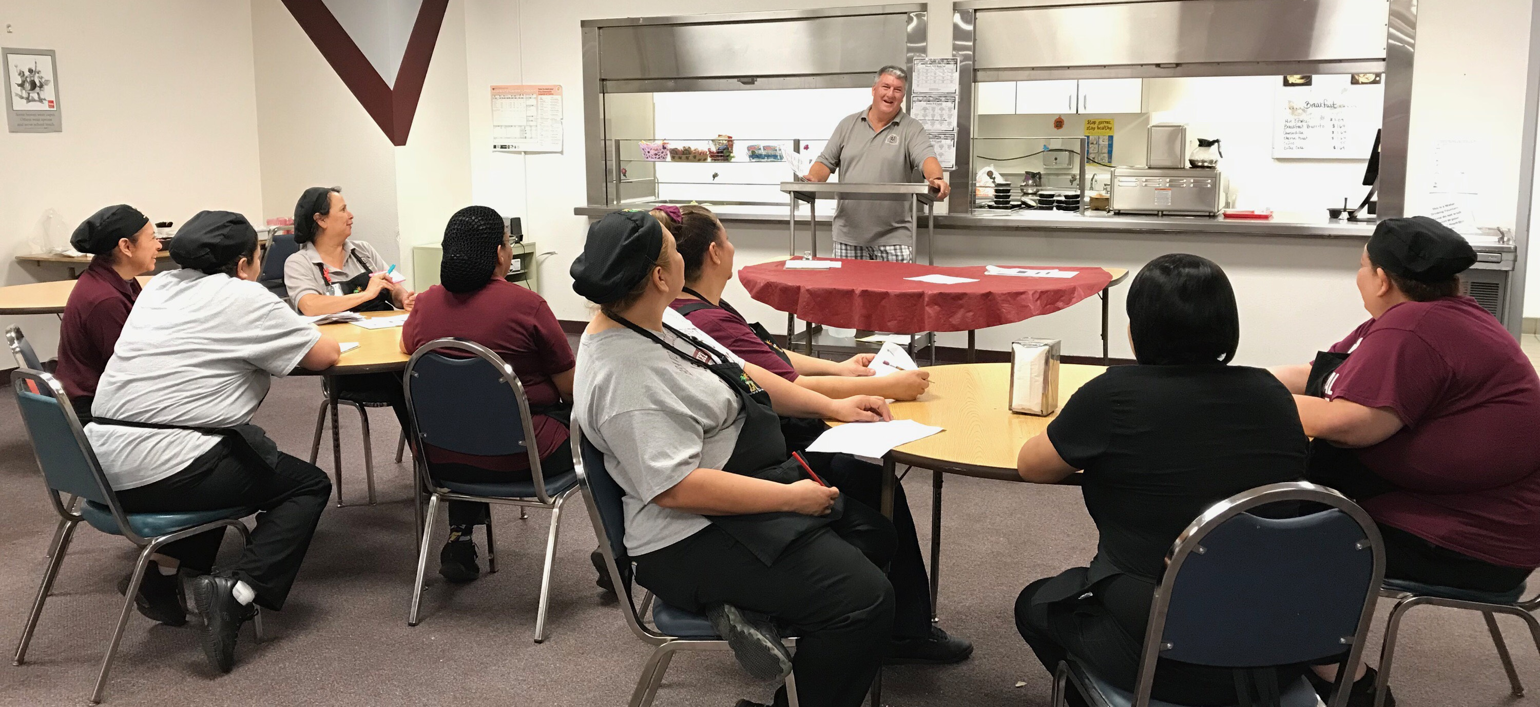
Staff Meeting & Announcements
Notes:
TELL: Staff meetings are a formal way of verbal communication.

Slide 21
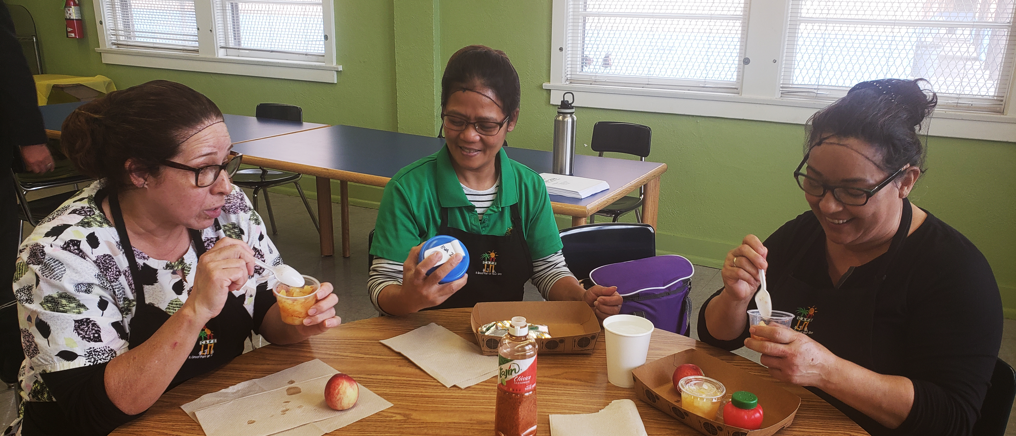
Informal Daily Conversations

Slide 22
Non-Verbal Communication
A large portion of our communication is non-verbal. We respond to thousands of nonverbal cues and behaviors; such as, facial expression, gestures, tone of voice, body language and appearance.
Notes:
TELL: Non-Verbal Communication
A large portion of our communication is non-verbal. We respond to thousands of non-verbal cues and behaviors everyday. Some examples of non-verbal communication would be facial expressions, gestures, tone of voice, body language and appearance.

Slide 23
Facial Expressions
Identify the Non-Verbal Cue
Notes:
ACTIVITY
TELL: Lets see if you can identify the different types of non-verbal cues.
ASK: Can anyone guess which type of non-verbal cue this picture is demonstrating?
SOLICIT AUDIENCE RESPONSE
TELL: That’s right, facial expressions.
Let’s take a look at the next example.

Slide 24
Gestures
Identify the Non-Verbal Cue
Notes:
ASK: What type of non-verbal cue do you think this is?
SOLICIT AUDIENCE RESPONSE
Exactly, gestures. Great Job!

Slide 25
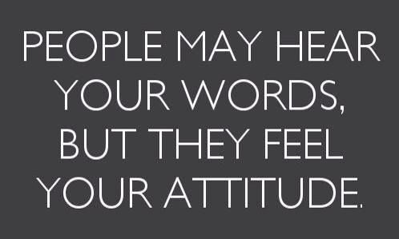
Tone of Voice
Identify the Non-Verbal Cue
Notes:
ASK: What non-verbal cue does this look like?
SOLICIT AUDIENCE RESPONSE
TELL: Correct, tone of voice. The tone of your voice can change the way a person receives your communication.

Slide 26
Body Language
Identify the Non-Verbal Cue
Notes:
ASK: What non-verbal cue do you think this is representing?
SOLICIT AUDIENCE RESPONSE
Tell: Body language. Your body language can tell someone a lot of how you are feeling, with out them even speaking with you.

Slide 27
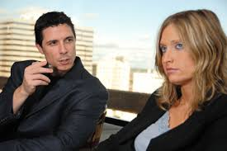
Eye Contact
Identify the Non-Verbal Cue
Notes:
ASK: Can anyone tell me what this non-verbal type is?
SOLICIT AUDIENCE RESPONSE
TELL: That’s correct, eye contact. Giving eye contact can tell someone you are listening to them, and they have your attention.

Slide 28
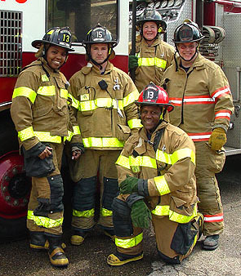
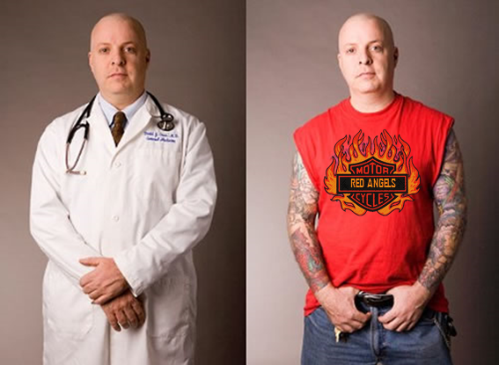
Appearance
Identify the Non-Verbal Cue
Clean vs. Dirty
Uniforms
Professional vs. Street wear
Notes:
ASK: What non-verbal cue does this represent?
SOLICIT AUDIENCE RESPONSE
TELL: Appearance. The way someone presents themselves is another example of a non-verbal cue. Looking at the first picture from the left, would you start your shift with an unclean apron? What does the middle picture tell us? What do for our society? The last picture on the right depicts a doctor in professional wear and in relaxed street wear when he is not at work.

Slide 29
Actions Speak Louder Than Words
Instructions:
Select a piece of paper from the bowl.
Without using any words, act out the emotion.
Then, the class will guess the emotion portrayed.
Hold on to your piece of paper for the next activity.
Notes:
ACTIVITY
TELL: Let’s take a moment and practice some non-verbal cues. This activity is called Actions speak louder than words. Everyone take a piece of paper from the bowl. Now without using words, act out the emotion and the class will try to guess the emotion.
SOLICIT FOR VOLUNTEERS, VOLUNTEERS WILL DEPEND ON TIME.

Slide 30
Watch Your Tone!
Instructions:
Say the sentence below with your emotion.
“You have got to be kidding me.”
Notes:
ACTIVITY
TELL: Now let’s do another activity called Watch Your Tone! Using the emotion listed on the paper, let’s go around the room and say following sentence for the class “You have got to be kidding me.”
AFTER THE ACTIVITY
TELL: As you can see from the activity, we all said the same exact thing, but it came across differently depending on the tone of voice used. Therefore, it is important to be mindful of your tone when communicating with others.

Slide 31
Visual Communication
Visual communication is the transmission of ideas and information using symbols, images, and words.
Notes:
TELL: Visual Communication. Visual communication is the transmission of ideas and information using symbols, images, and words.

Slide 32
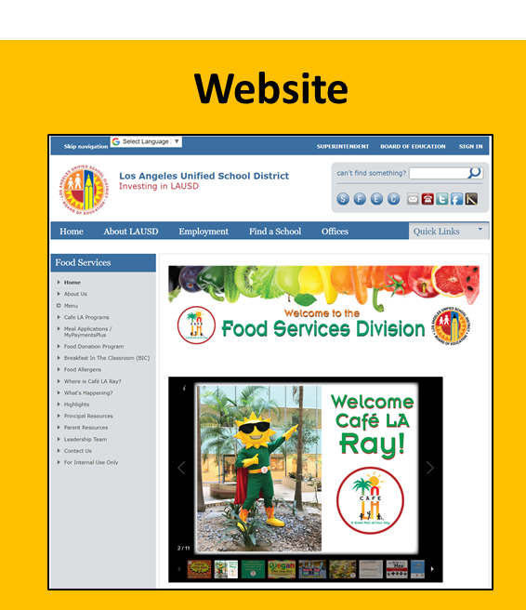
Notes:
TELL: Here are some examples of visual communication; training videos, menus, websites, banners and signs.

Slide 33
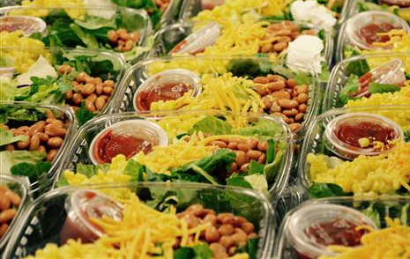
The Gold Standard
It is one thing to verbally instruct your staff to prepare food according to the gold standard, and another to create a visual guide for them to follow.
Notes:
TELL: The Gold Standard. It is one thing to verbally instruct your staff to prepare food according to the gold standard, and another to create a visual guide for them to follow.

Slide 34
Written Communication
Written communication is the most common and effective mode of business communication.
Notes:
TELL: Written Communication. Written communication is the most effective and commonly used form of communication in business.

Slide 35
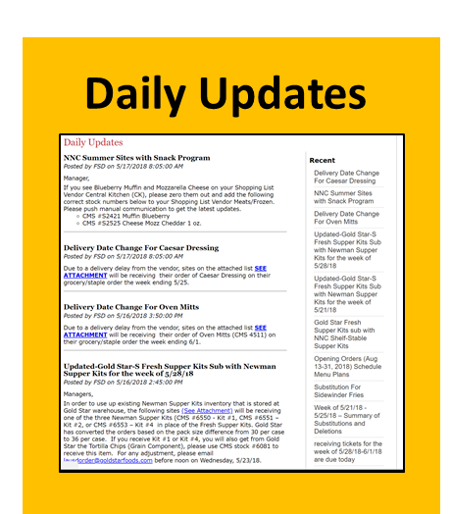
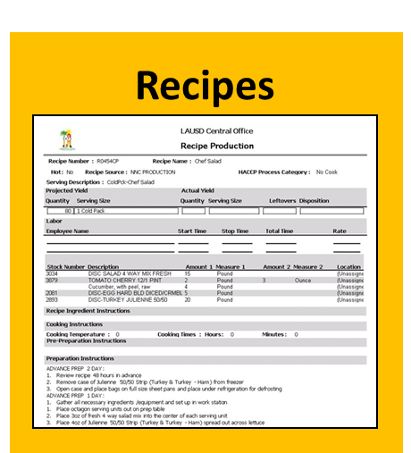
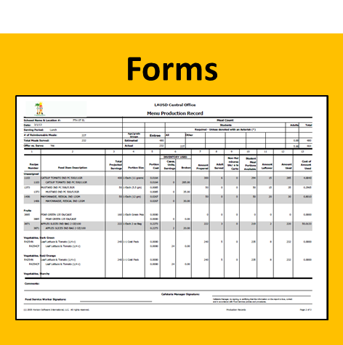
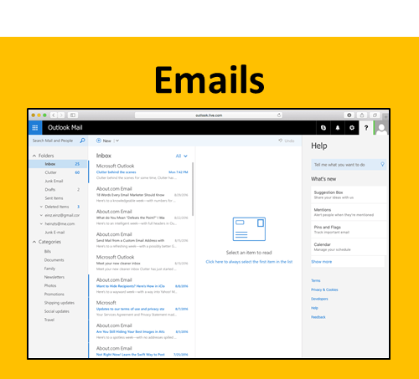
Notes:
TELL: Daily updates, forms, policies and procedures, recipes, and emails are some great examples of written communication.

Slide 36
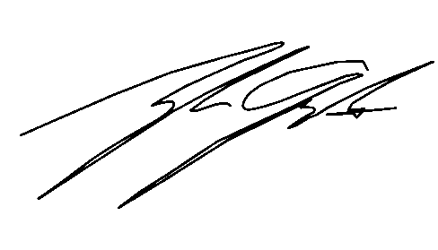
What Does Your Signature Mean?
Signature:
When you sign a document you acknowledge that the document has been reviewed and you are verifying that the information is accurate.
Notes:
TELL: One of the most important written communication tool we use is our signature. When you sign something, what does it mean? From signing a credit card receipt after making a purchase, or accepting a job offer to the daily forms we use in the cafeteria, when you sign a document you acknowledge that the document has been reviewed and you are verifying that the information is accurate.

Slide 37
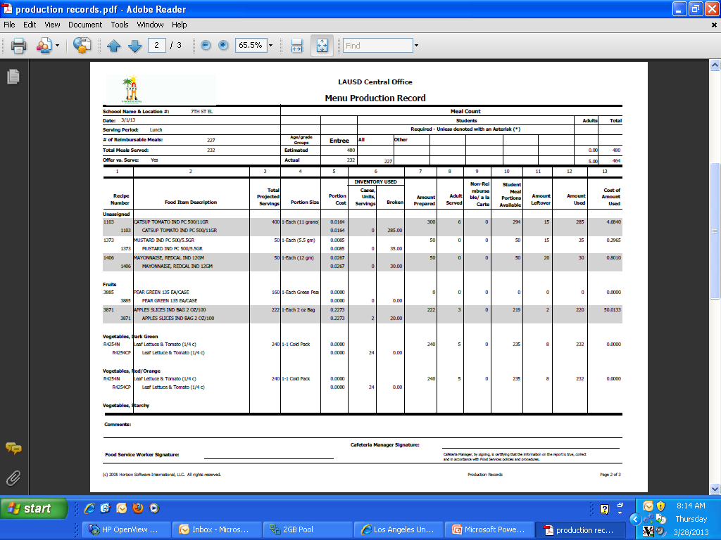
Production Record
By signing any document, you are certifying that the information on the report is true, correct and accurate with Food Services policies and procedure.
Notes:
TELL: For example , a form we use daily, the Production Record. By signing any document, you are certifying that the information on the report is true, correct and accurate with Food Services policies and procedure.

Slide 38
Effective Communication Strategies with Customers
Customer service is essential to ensure that we are meeting our customer’s needs:
Learn names
Encourage students to try menu items
Conduct “table rounds”
Notes:
TELL: Remembering the 4 types of communication, verbal, non-verbal, visual and written. Here are some ways we can improve communication and customer service. We can make the effort to learn names, encourage students to try menu items,
Conduct table rounds during service times.

Slide 39
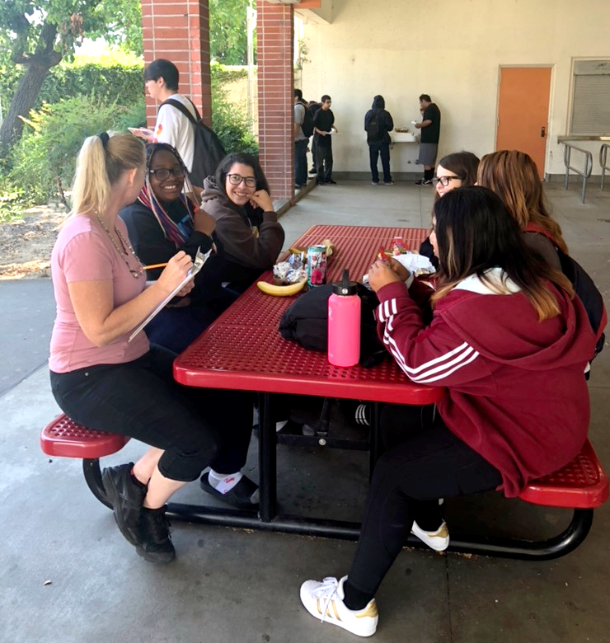
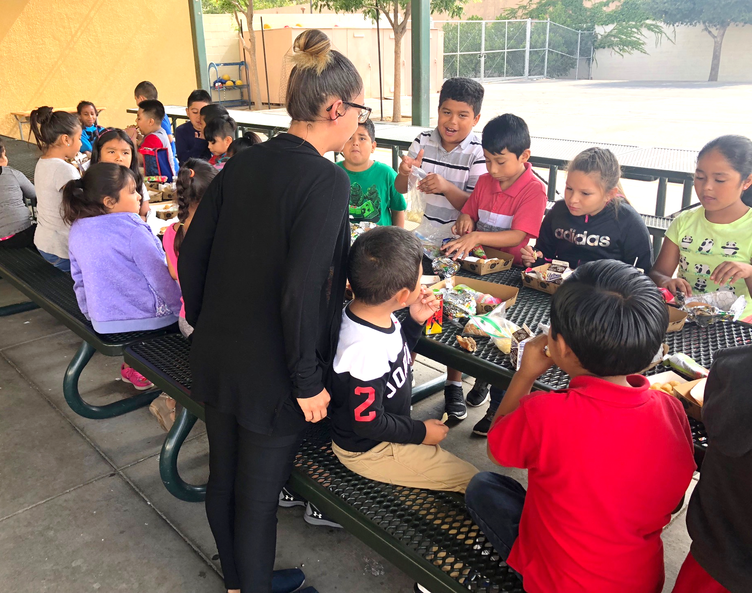
The Art of Table Rounds
“Table Rounds” refers to the interaction between staff and its customers. FSMs are encouraged to step outside their kitchens to connect with their students:
Smile
Meet and greet
Engage in conversation
Encourage healthy habits
Ask questions
Notes:
TELL: Commonly known in the restaurant world as “Table Touching”, “Table Rounds” refers to the interaction between staff and its customers. FSMs are encouraged to step outside their kitchens to connect with their students. Smile and spread positivity, meet and greet, engage in conversation, encourage healthy eating habits, ask questions. Make your rounds daily and build stronger relationships with your students.

Slide 40
Effective Communication Strategies with School Faculty
It is important to maintain good relations with your school administrations and faculty:
Visit the main office:
Smile, say hi, and be seen
Communicate regularly:
Practice positive and constructive communication regularly
There is a right time and place for everything
Notes:
TELL: It is important to maintain good relations with your school administrations and faculty. Visit the main office: Smile, say hi, and be seen. Regular communication: Have both positive and negative communication. Do not communicate only where there is an issue, if so, every time you reach out, they will feel negative and not look forward to it. There is a right time and place for everything. Everyone is busy, be respectful of their time.

Slide 41
Effective Communication Strategies with Cafeteria Staff
Below are tips to help your operation run smoothly:
Cultivate a positive environment
Be a good role model
Get to know your staff
Recognize and praise your staff
Communicate clearly and effectively daily
Notes:
Tell: Effective Communication Strategies with School Faculty. It is important to maintain good relations with your school administrations and faculty. Here are some examples on how to do just that; Visit the main office: Smile, say hi, and be seen.
Communicate regularly: Practice positive and constructive communication regularly
And remember there is a right time and place for everything.

Slide 42
Pre-Shift Meeting Tips
Plan Ahead
Set a Location
Keep it Short & Simple
Show & Tell
Stay Focused
Ask Better Questions
Provide Recognition & Praise
Notes:
TELL: 1. Plan Ahead
Prepare a short list of points
2. Set a Location
A set location will help save time and enforce timely attendance
3. Keep it Short and Simple
Keep the meeting around 2 minutes
4. Show & Tell
Bring materials to the meeting for visual aid
5. Stay Focused
Focus on the main topics and revisit side topics after the meeting
6. Ask Better Questions
Ending the meeting with “Any questions?” will illicit no response, ask direct questions.
7. Give some Praise
Start your meeting on a positive note. Recognition and gratitude are great motivators.

Slide 43
Operations
Daily Forecast
Discuss menu, OVS, reimbursable meals, pricing, items substitutions, new items on the menu
Special events could affect sales: field trips, inclement weather, and holidays.
Pre-Shift Meeting Topics
Motivate your staff by providing positive feedback. Take this opportunity to thank individuals.
Reinforce training, review policies and procedures, safety reinforcement
Training
Inspiration
Notes:
TELL: There are four general areas in your pre-shift meetings that you should discuss during the course of the week; operations, forecasting, training and inspirations.
This is a great opportunity to discuss forecasting with any outliers for the day. You can discuss the day’s menu, what items need to be offered or taken to create a reimbursable meal, changes to the pricing if applicable, any item substitutions to the menu or take about the exciting new items on the menu. Correspond to your staff of any special events that could affect your operations, such as field trips, holiday, parties, and student testing. Also confer with them on how to precede their task for the day, thus creating teamwork for all. Training should be the primary focus of your pre-shift meetings. Use these minutes to reinforce training, review pertinent policies and procedures or reinforce safety measures.
It is just as important to uplift your employees with some inspiration, especially when the week has been challenging. Point out any positive actions that you and your staff have noticed. Keep your staff motivated and encourage them to stay positive. It is essential to end your meeting on a high note and share any positive happenings amongst the employees.

Slide 44
Pre-Shift Meeting Activity
Incorporate the different types of communication when delivering your meeting.
Break into 3-4 Groups
Appoint pre-shift meeting leader
Discuss 3 different topics
You have 5 minutes to prepare your pre-shift meeting script
Then you will have 2 minutes to present your topics in front of class
Click to Advance to Timer
Notes:
TELL: There are four general areas in your pre-shift meetings that you should discuss during the course of the week; operations, forecasting, training and inspirations.
This is a great opportunity to discuss forecasting with any outliers for the day. You can discuss the day’s menu, what items need to be offered or taken to create a reimbursable meal, changes to the pricing if applicable, any item substitutions to the menu or take about the exciting new items on the menu. Correspond to your staff of any special events that could affect your operations, such as field trips, holiday, parties, and student testing. Also confer with them on how to precede their task for the day, thus creating teamwork for all. Training should be the primary focus of your pre-shift meetings. Use these minutes to reinforce training, review pertinent policies and procedures or reinforce safety measures.
It is just as important to uplift your employees with some inspiration, especially when the week has been challenging. Point out any positive actions that you and your staff have noticed. Keep your staff motivated and encourage them to stay positive. It is essential to end your meeting on a high note and share any positive happenings amongst the employees.

Slide 45
Transition Slide Only
Notes:
PLACEHOLDER FOR ANIMATION

Slide 46
2 Minute Timer
Time’s Up!
Click Here to Restart Timer
Click Anywhere to Start Timer
Notes:
ANIMATION: USE THIS TIMER FOR THE PRE-SHIFT MEETINGS.

Slide 47
You Play a Large Role in Your School Village
As engaging partners in the village, we must continue to be committed to active communication and school involvement beyond the walls of our cafeterias.
No one can do it alone, it takes a village, let’s do our part to prepare students to achieve excellence.
Notes:
TELL: As engaging partners in the village, we must continue to be committed to active communication and school involvement beyond the walls of our cafeterias. No one can do it alone, it takes a village, let’s do our part to prepare students to achieve excellence.

